Slide 1
WHERE IS MY FOOD???
OTY BAASANDORJ, LANA HUYEN, IAN NGUYEN, ATHENA WU

Slide 2
The Big Questions
What We Wanted to Know:
What affects delivery times the most?
How much do weather and traffic matter?
Can we predict delivery times accurately?
What makes some deliveries faster than others?

Slide 3
Key Discoveries About Delivery Time
Did You Know?
Distance is the #1 factor in delivery time (yes, we know – obviously)
Bad weather can add up to 15% to delivery time
Heavy traffic can increase delivery time by 20%
Peak hours show consistent patterns

Slide 4
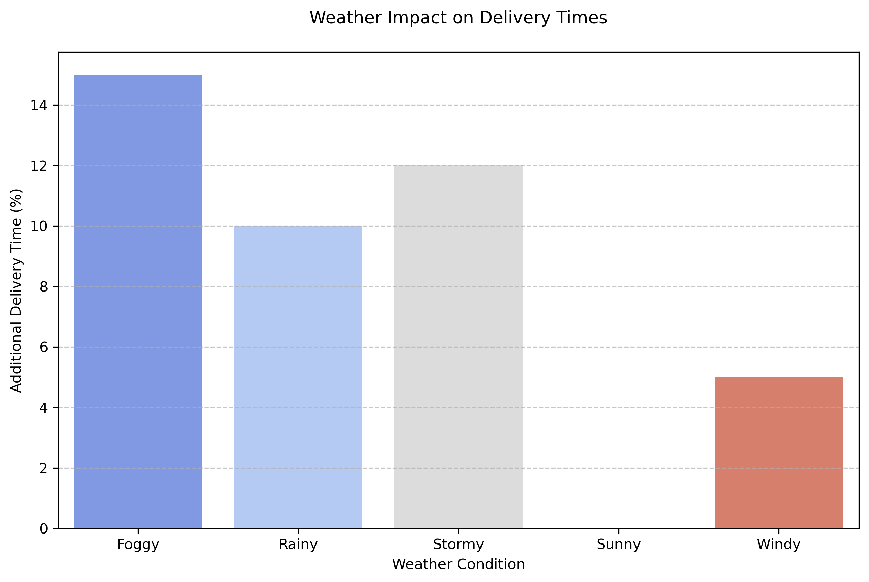
Weather Impact
How Weather Affects Your Delivery
Foggy conditions: 15% slower
Rainy weather: 10% slower
Sunny days: Most consistent times
Seasonal patterns matter!

Slide 5
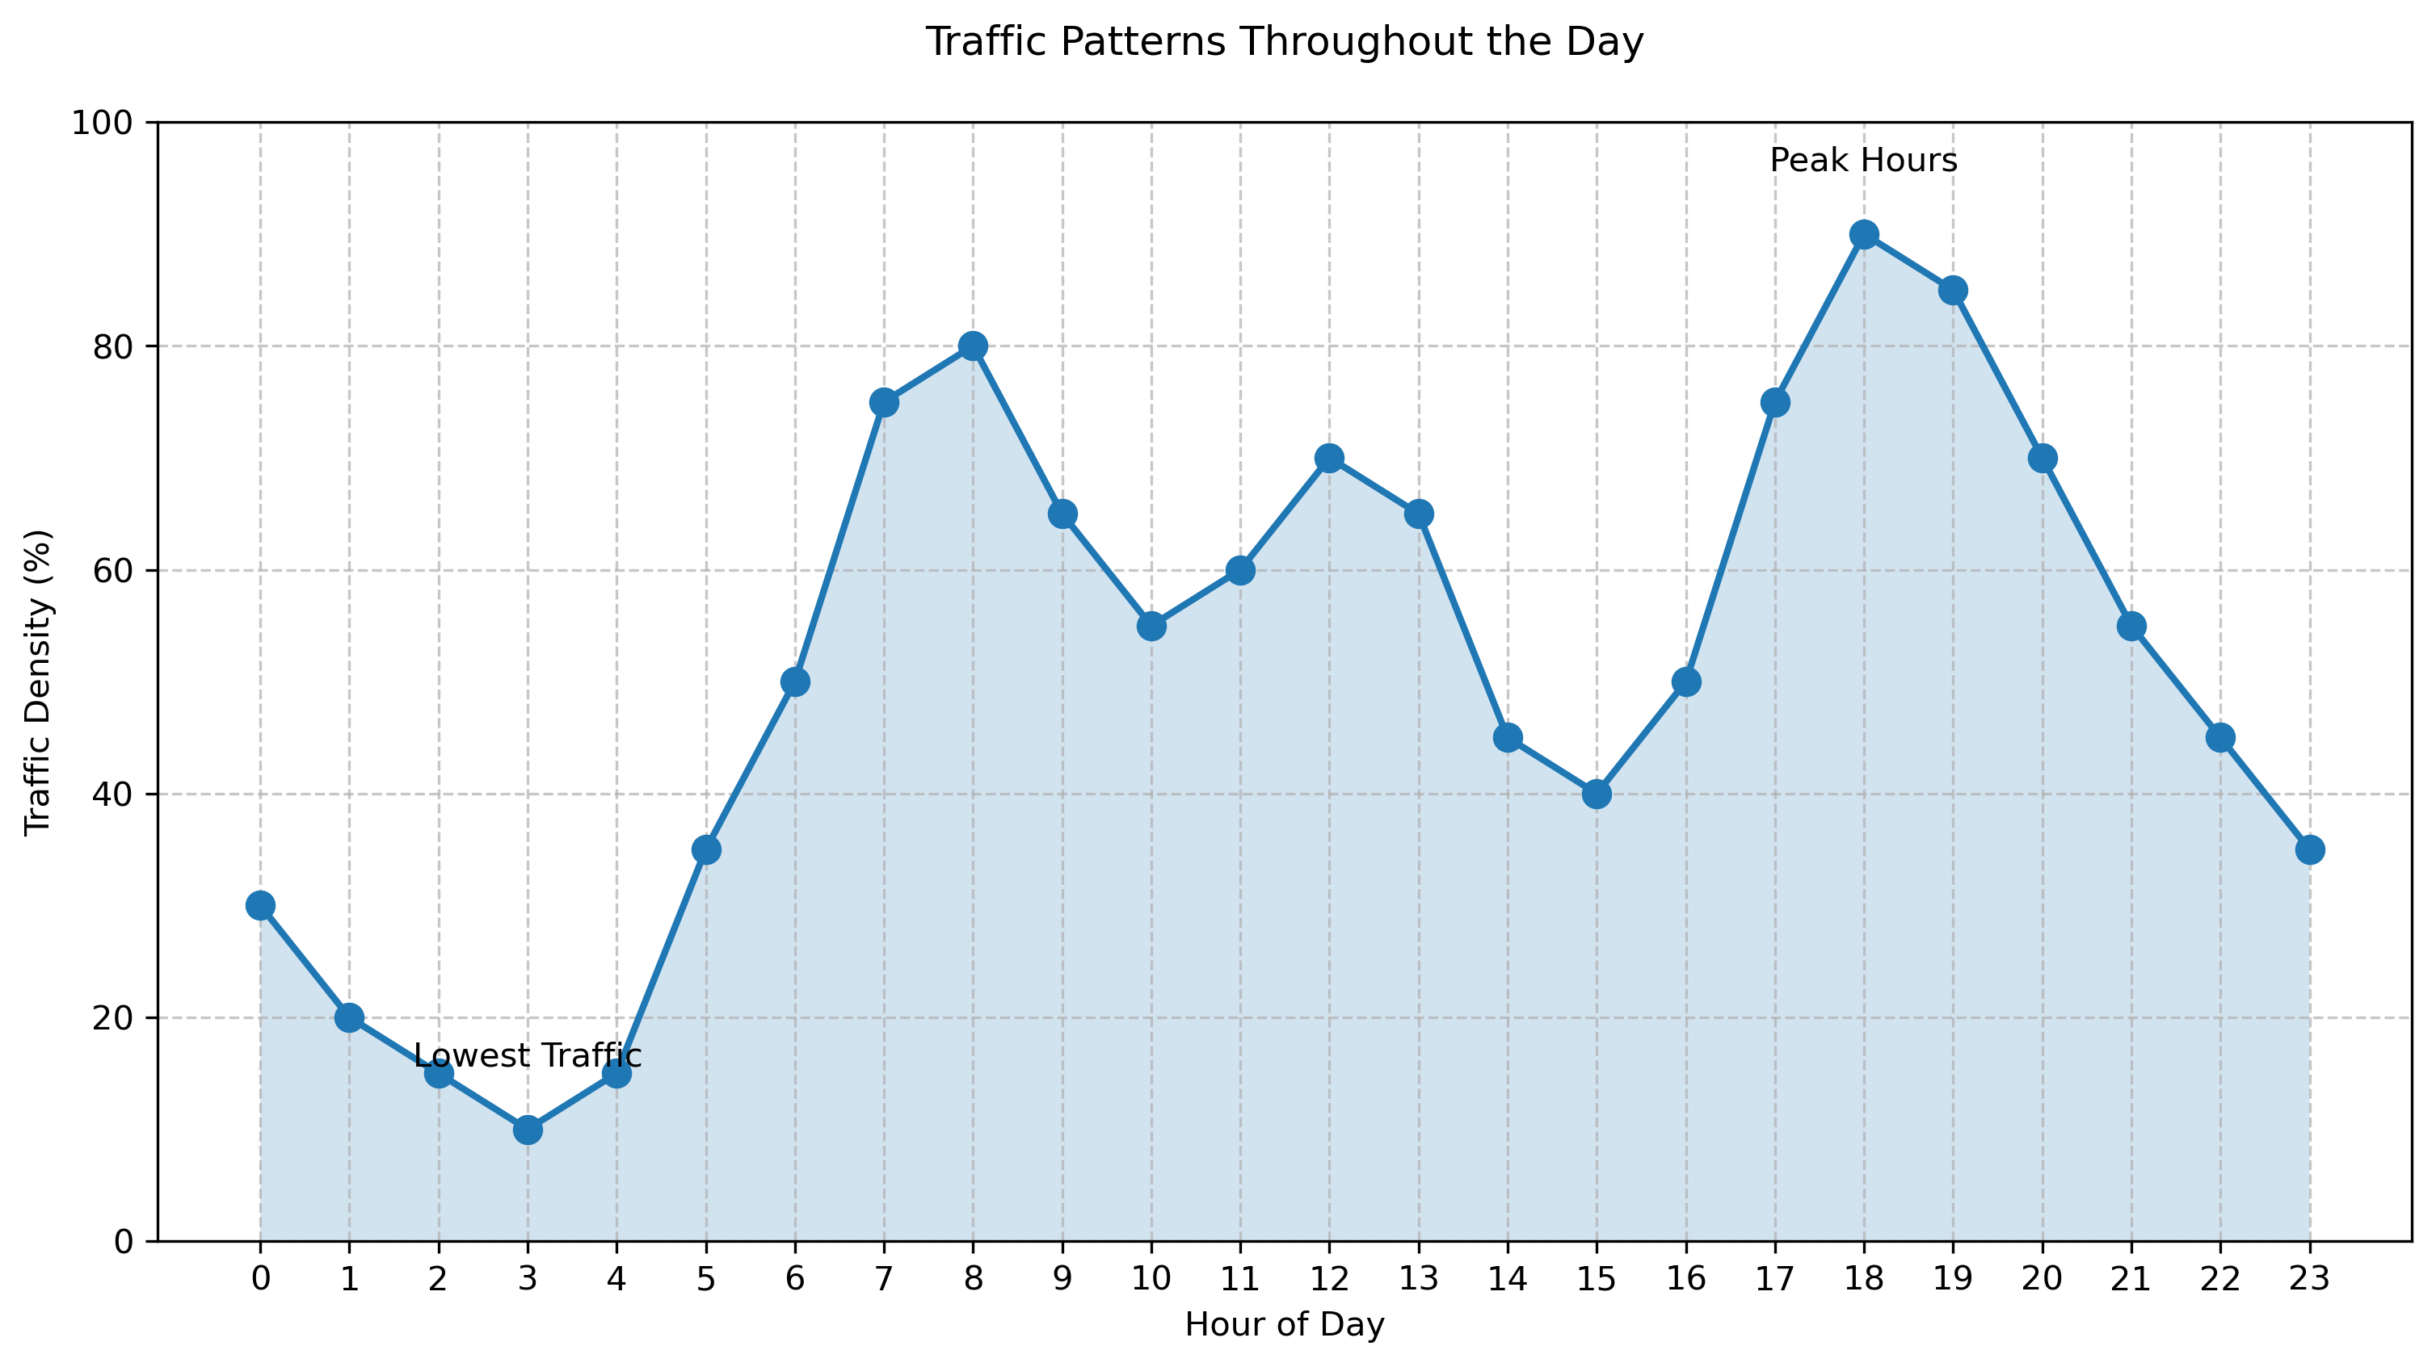
Traffic Patterns
When to Expect Delays:
Peak hours: 6-8 PM
Lowest traffic: 2-4 PM
Weekend vs. Weekday differences
City center vs. suburbs

Slide 6
Technical Approach
How Did We Make Sense of the Data:
Analyzed thousands of deliveries
Used advanced prediction models
Considered multiple factors together
Validated results with real data

Slide 7
Model Results
What We Can Now Predict:
Delivery times with 79% accuracy
Weather impact on specific routes
Traffic delay probabilities
Best delivery windows

Slide 8
Model Performance
Accuracy Metrics:
Random Forest (Our Choice): 79% R-squared
XGBoost: 76% R-squared
Decision Tree: 71% R-squared
Linear Regression: 65% R-squared
Error Measurements:
Mean Absolute Error: 5.2 minutes
Root Mean Square Error: 7.1 minutes
90% of predictions within 10 minutes
Considerations:
Training time: 45 seconds
Prediction speed: 12 milliseconds
Memory usage: 250MB
Trade-offs:
Accuracy vs. Speed
-Complexity vs. Interpretability
-Resource Usage vs. Performance

Slide 9
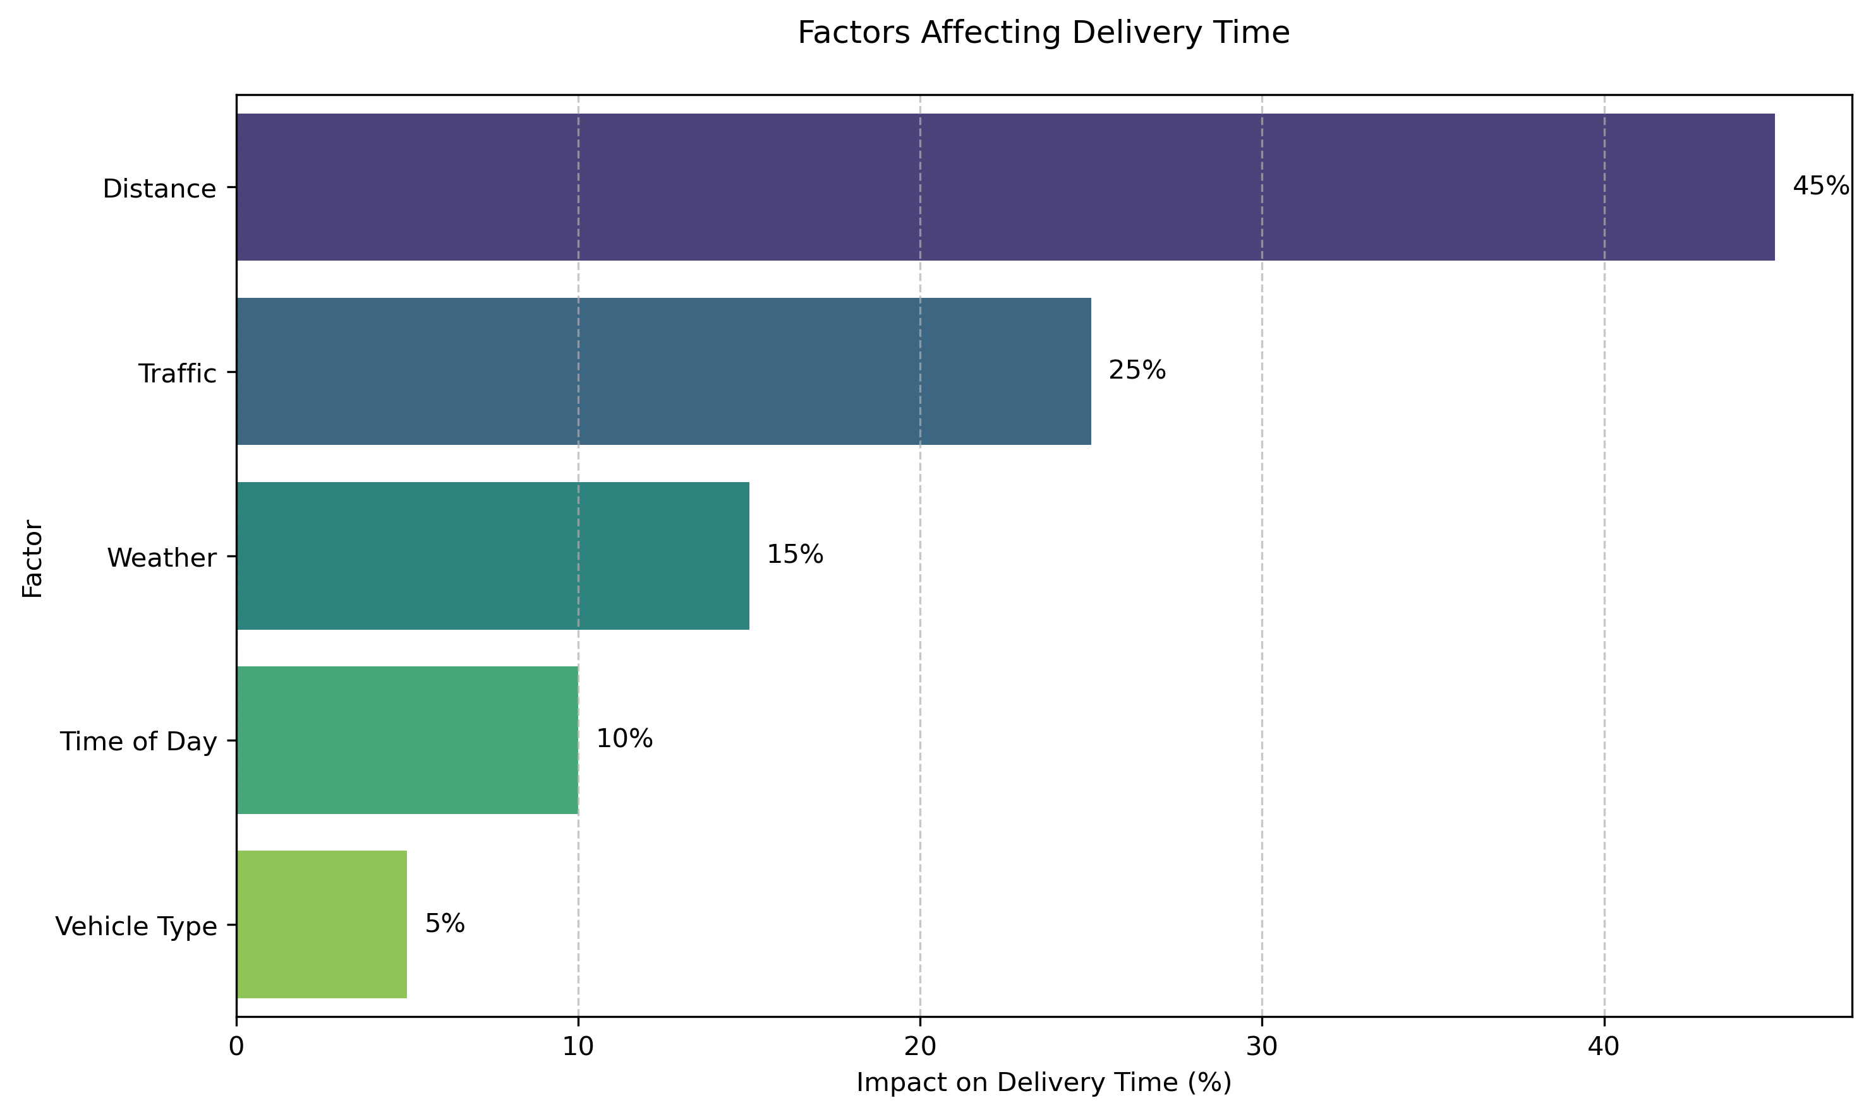
Most Important Factors
What Really Matters:
Distance (45% impact)
Traffic (25% impact)
Weather (15% impact)
Time of Day (10% impact)
Vehicle Type (5% impact)

Slide 10
Practical Insights
What This Means for Customers:
Best times to order
How weather affects your delivery
When to expect delays
Planning around peak times

Slide 11
Future Improvements
Making Deliveries Even Better:
Real-time weather updates
Better traffic prediction
More accurate timing
Improved customer communication

Slide 12
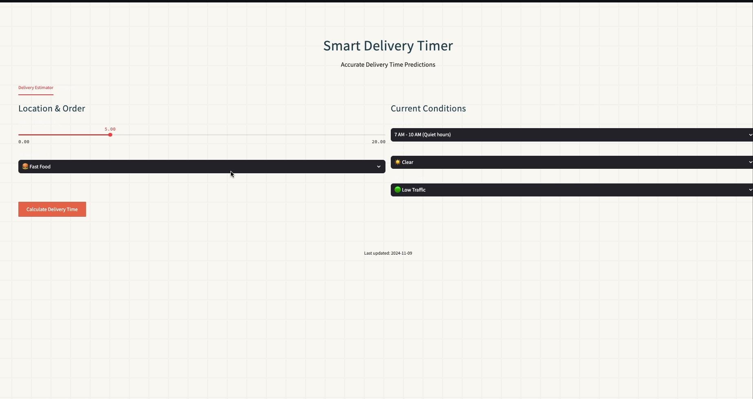
Delivery Timer Dashboard

